Slide 1

Rockbuster Stealth LLC 2020 Company Strategy
Kilian Loeffner

Slide 2
KEY INFORMATION
Rockbuster Stealth LLC is a movie rental company that used to have stores around the world. Facing stiff competition from streaming services such as Netflix and Amazon Prime, the Rockbuster Stealth management team is planning to use its existing movie licenses to launch an online video rental service in order to stay competitive.
Total Revenue $ 61.312
Movies
4580
Rentals 14596
Stores
2
Customers 584
Countries 109

Slide 3

KEY SECTIONS
Best and worst performing movies and genres
Key Rental data
Geographical Distribution

Slide 4
Top and worst movies by revenue
Movie Title | Revenue
Telegraph Voyage | 215.75 $
Zorro Ark | 199.72 $
Wife Turn | 198.73 $
Innocent Usual | 191.74 $
Hustler Party | 190.78 $
Saturday Lambs | 190.74 $
Titans Jerk | 186.73 $
Harry Idaho | 177.73 $
Torque Bound | 169.76 $
Dogma Family | 168.72 $
Movie Title | Revenue
Oklahoma Jumanji | 5.94 $
Texas Watch | 5.94 $
Duffel Apocalypse | 5.94 $
Freedom Cleopatra | 5.95 $
Young Language | 6.93 $
Rebel Airport | 6.93 $
Cruelty Unforgiven | 6.94 $
Treatment Jekyll | 6.94 $
Lights Deer | 7.93 $
Stallion Sundance | 7.94 $

Slide 5
Most Profitable GENRES
Sports
$4892
Sci-Fi
$4336
Animation $4245
Drama $4118
Comedy $4002

Slide 6
Key rental Data
Rental Duration
MIN: 3 days
MAX: 7 days
Average: 4,93 days
Rental Rate
MIN: $0,99
MAX: $4,99
Average: $2,94
Most Frequent Movie Language
English

Slide 7
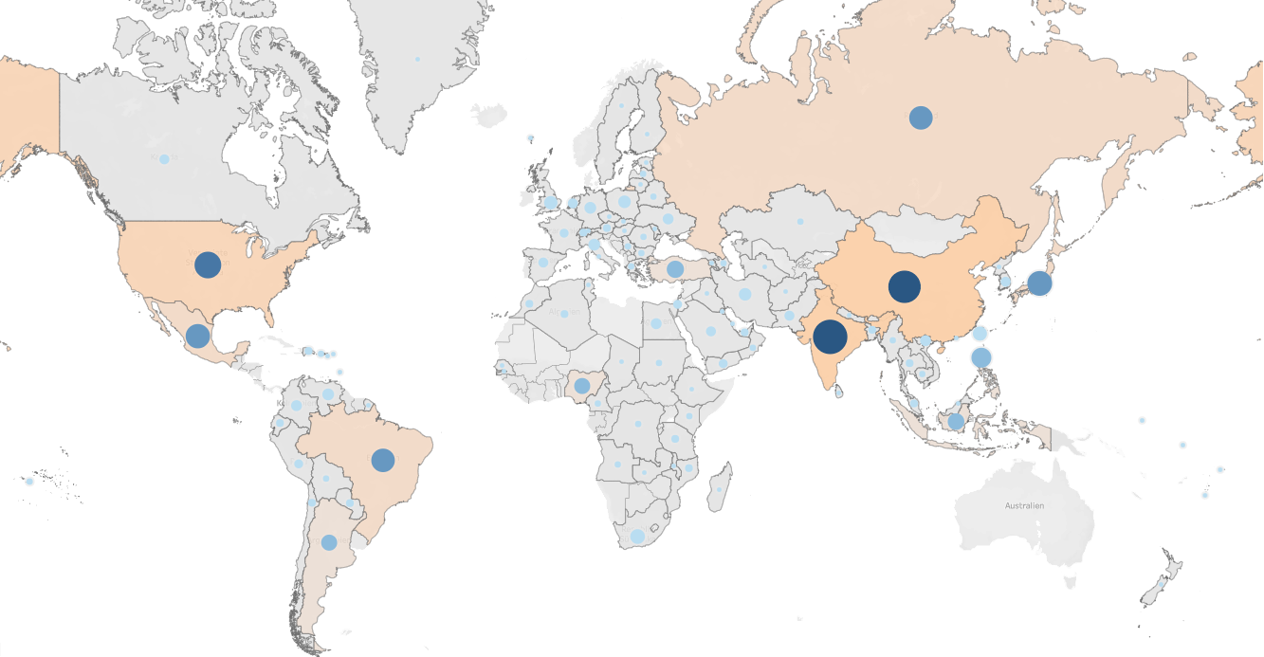
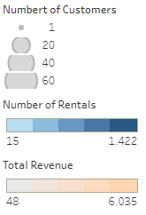
GEOGRAPHICAL CUSTOMER AND SALES DISTRIBUTION

Slide 8
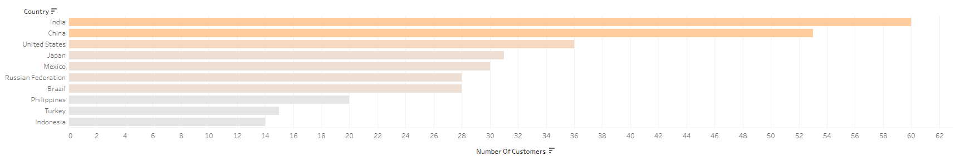
Top 10 COUNTRIES
Customers in Taiwan, Vietnam and the Philippines tend to spend the most money for movies.

Slide 9
SUMMARY
Top Genres
Sports
Sci-Fi
Animation
Drama
Comedy
Top Countries
India
China
United States
Japan
Mexico
Top Regions
Asia
United State
Central Europe
Countries with Most Valuable Customer
Taiwan, Vietnam and Philippines

Slide 10
Recommendations
Movie Inventory
Remove bad performing movies
Add more movies within the TOP5 genres: Sports, Sci-Fi, Animation, Drama and Comedy
Focus on movies designed for the asian market, most movies on Rockbuster are in english
Marketing Target Areas
1. Asian Market: India, China, Japan, Philippines, Indonesia, Taiwan and Vietnam
2. American Market: United States, Mexico, Brazil, Argentina
3. Central European Market

Slide 11

Thank you for your attention!
Presented by: Kilian Loeffner
Contact: KilianLoeffner@gmail.com
Tableau Visualizations: Visualizations

